Slide 1
RTS preventable accidents identification
Final presentation
Team 7

Slide 2
Team Members
Xiaoran Li
Project Manager
Second-year MS Data Science Student
Weiran Lin
Algorithm Engineer
Second-year MS Data Science student
Melissa Chen
Algorithm Engineer
Second-year MS Data Science student
Weinan Hu
Algorithm Engineer
Second-year MS Data Science student
Notes:
To begin with, let me introduce our team members. My name is Xiaoran Li, I am the project manager who takes the responsibility for communicating with stakeholders, scheduling resource, and controlling. My team members Weiran Lin, Weinan Hu, and Melissa Chen are all algorithm engineers, contributing a lot to data processing, statistical analysis and modeling.

Slide 3
Agenda
Introduction
Data Overview
Predictive Analysis
Causal Analysis
Future Work
Notes:
Now, let us see today’s agenda. Our presentation contains 6 parts. Firstly, we will have a project introduction and tell you what problems are we solving. Secondly. We will go over the milestone and track progress. Then, we will showcase the lasted work in the data science part. After that, we will share feedback from sponsors, presenting our documentation, and have an outlook for the rest part of the work.

Slide 4
Introduction
1
Notes:
First, Introduction

Slide 5
Business Understanding
Take actions
Improve the quality of service
decrease cost
avoid unnecessary injuries and damages
Identify causality
+ prediction
Notes:
Let me introduce the business understanding first. In recent years, consistently preventable accidents reduced service quality in RTS. We want to identify the underlying causes of preventable accidents and develop models to predict these accidents beforehand. With this information, RTS can take effective actions to reduce future preventable accidents. In this way, RTS can improve the quality of service, decrease cost. And more importantly, avoid unnecessary injuries and damages.

Slide 6
Vision & Goals
Vision
Reduce future preventable accidents and improve safety.
Goals
Identify potential causes of preventable accidents.
Deliver reusable models to predict future preventable accidents.
Notes:
In each of the last 5 years RTS has consistently had approximately 100 preventable accidents of varying severity. Since that, we want to reduce future preventable accidents and improve safety. Our goals are identifying potential causes of these preventable accidents and deliver reusable models to predict future preventable accidents.

Slide 7
Data Overview
2
Notes:
Second,

Slide 8
Data Integration
Absence
Operator ID
Absence Date (08/24/2015 – 08/31/2019)
Absence Type
...
Timeline
Date (04/04/2016 – 09/02/2019)
Operator ID (1 - 430)
Activity 0
Activity 1
…
Activity 15
Operator Activities Statistics vs Date
Scheduled Days Off
Operator ID
Effective Date (04/04/2016)
End Date (09/02/2019)
Weekday
…
Timeline Analysis

Slide 9
Timeline Data
 | 1 | 2 | 3 | …… | 430 | C0 | C1 | C2 | …… | C15
2016/4/4 | 10 | 10 | 10 |  | 0 | 106 | 0 | 0 | 3 | 1
2016/4/5 | 1 | 1 | 1 |  | 0 | 107 | 227 | 28 | 12 | 0
2016/4/6 | 1 | 1 | 4 |  | 0 | 107 | 226 | 28 | 16 | 0
2016/4/7 | 1 | 1 | 1 |  | 0 | 107 | 228 | 33 | 12 | 0
2016/4/8 | 1 | 1 | 4 |  | 0 | 106 | 223 | 27 | 17 | 0
2016/4/9 | 9 | 2 | 2 |  | 0 | 107 | 87 | 176 | 7 | 0
2016/4/10 | 2 | 9 | 2 |  | 0 | 107 | 66 | 199 | 6 | 1
……

Slide 10
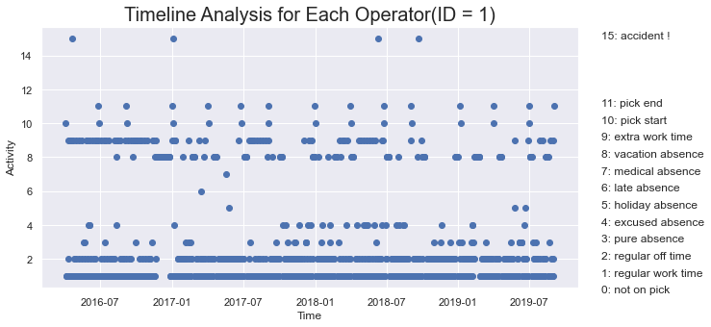
Timeline Analysis
BAITFISH Code
Timeline range from 2016-04-04 to 2019-09-02
Operators have different timelines
Timelines as features

Slide 11
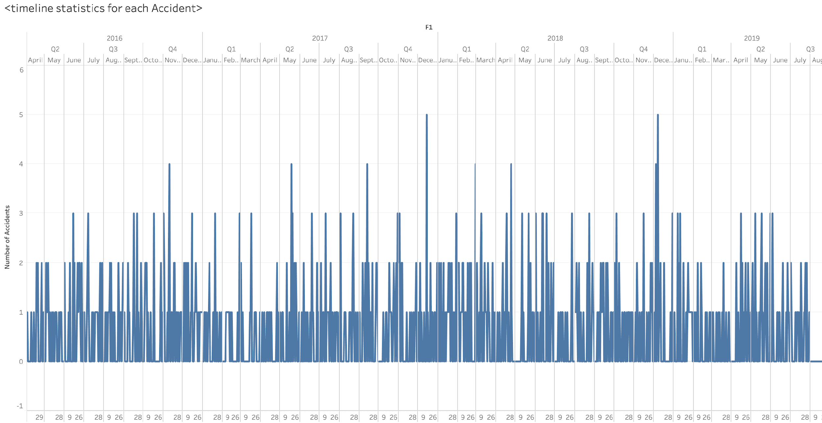
Timeline Analysis
Statistics on all activities
Time lag patterns
Activity(accident) statistics on all operator

Slide 12
Data Integration
Accident Data
Date (04/20/2016 – 07/09/2018)
Address
Operator
Road Condition
Weather
...
Timeline
Date (04/04/2016 – 09/02/2019)
Operator ID (1 - 430)
Activity 0
Activity 1
…
Activity 15
15 Lag Variables
Lat, Lng
Street Speed Limit,
Accident Frequency
Near Hotspot
Add Lag Variables
Geolocation Analysis

Slide 13
Data Cleaning
# Accidents 1159
# Missing Value:
309 in Location,
617 in Vehicle Occupancy
# Cleaned Accidents 842
Add geoinformation
# Accidents :1159
# Lag Variables 735
# Locations: 835
# Wrong Value:
11 in Accident
Year
# Lag Variables: 739
# Duplicate Value: 0
# Cleaned: 397
# Merged Accidents data 397

Slide 14
Data Description
497 rows and 42 columns
Column Type | Column Name
Operator ID
Vehicle | vehicle maker, year
Road | Rode type, light, weather, light, surface
Address | Address neighborhood, type, long, lat, speed limit, frequency near hotspot
Time | Year, Month, Date, Time(Morning, Afternoon, Night, Before Morning)
Lags | 12 Activities’ Lags, Frequency of absence/extra work
Target | Preventability

Slide 15
Predictive Modeling
3
Notes:
Third,

Slide 16
Machine Learning Models Development Procedure
Further Data Preparation
Data preparation ⇄ Modelling
Increase cohesion of data types/scales
1
Deal with Data leakage problem
Fit into popular and suitable machine learning models
Feature Engineering and Model Fitting
2
Model Evaluation
Accuracy, ROC, Cohen's kappa, Time consumption
Feature contribution and Decision boundary
3

Slide 17
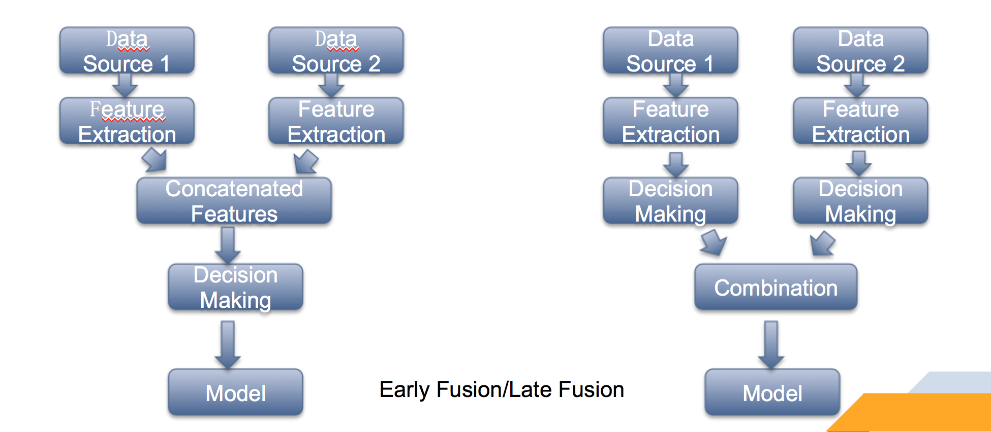
Feature Engineer

Slide 18
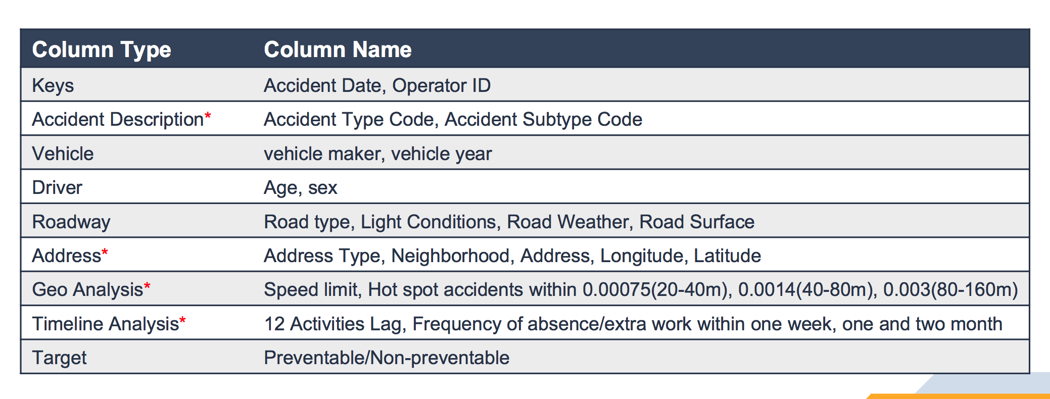
Feature Engineer

Slide 19
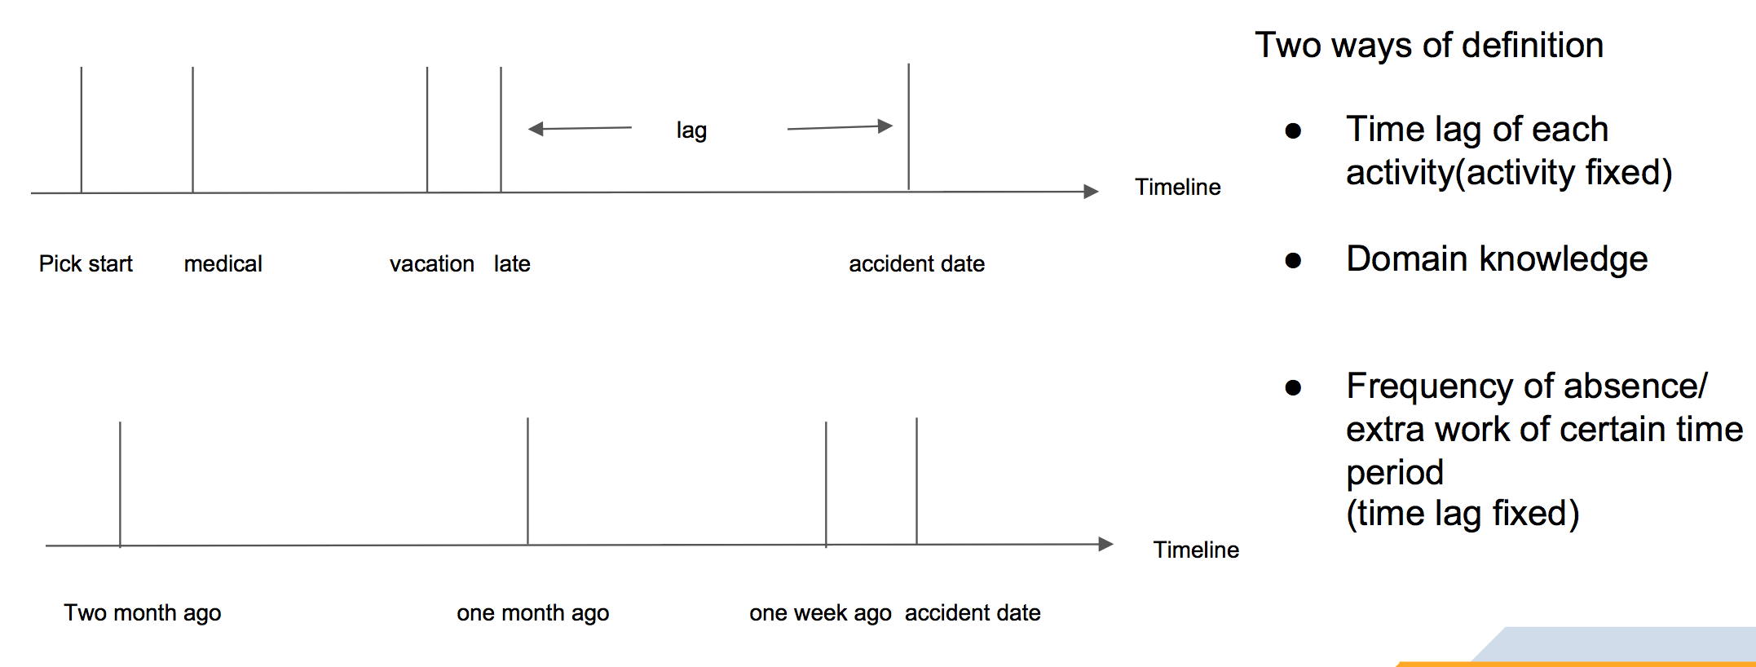
Lag Variables Definition

Slide 20
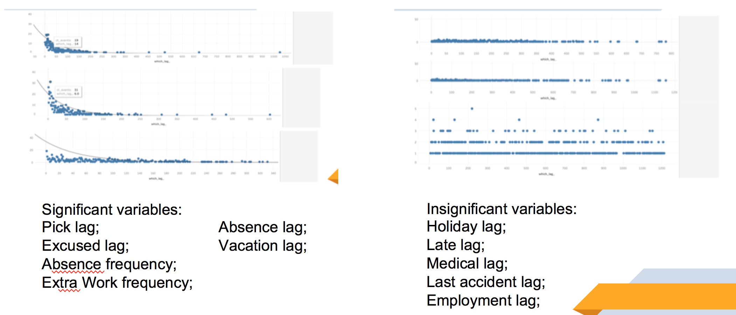
Feature Selection(0)

Slide 21
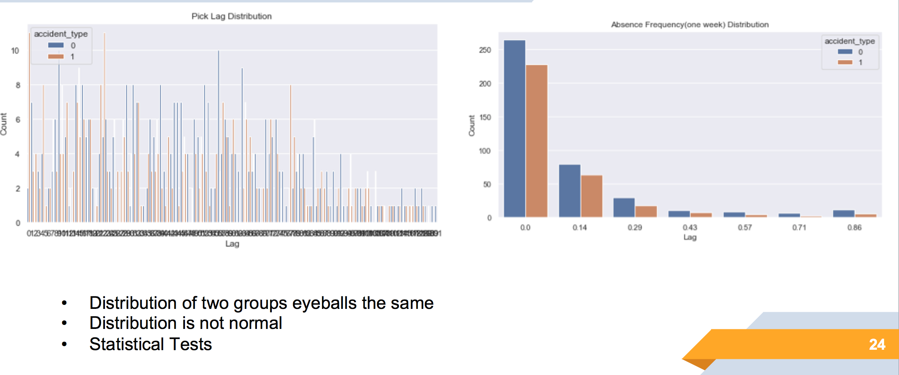
Feature Selection(1)

Slide 22
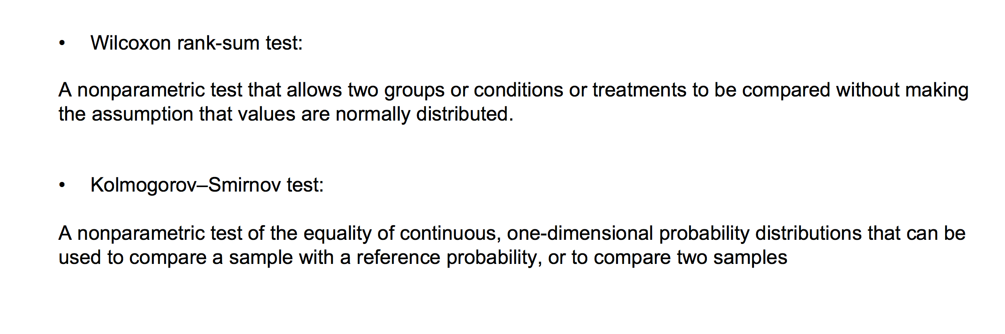
Feature Selection(1)

Slide 23
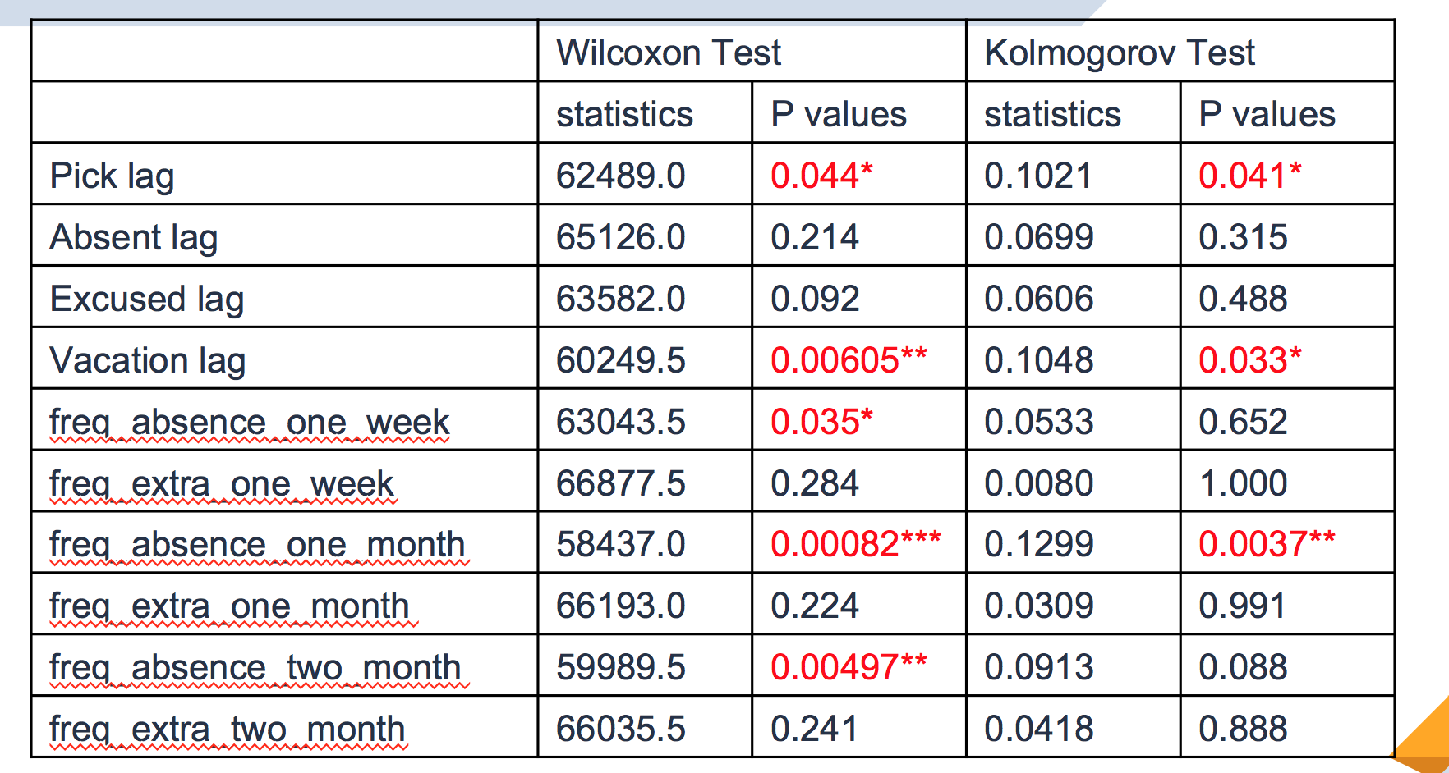
Feature Selection(1)

Slide 24
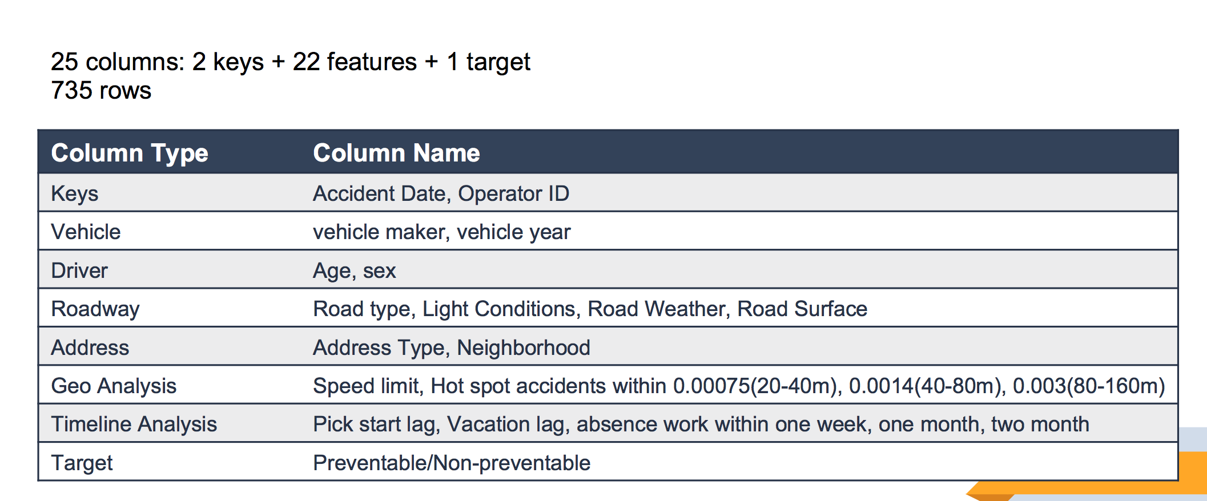
Feature Engineering

Slide 25
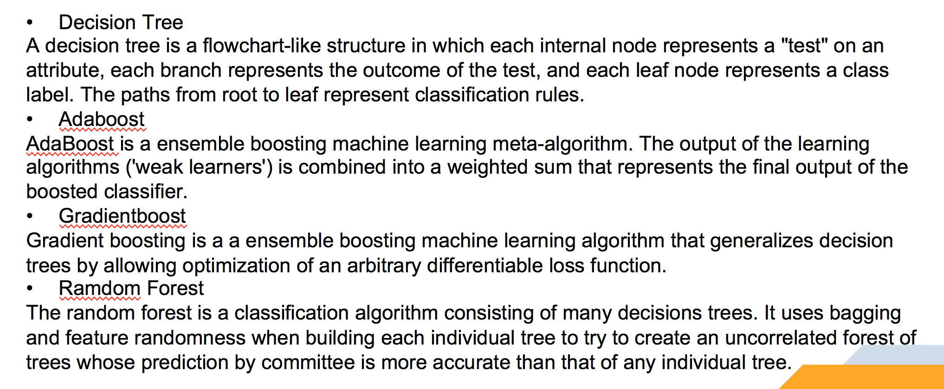
Models Fitting

Slide 26
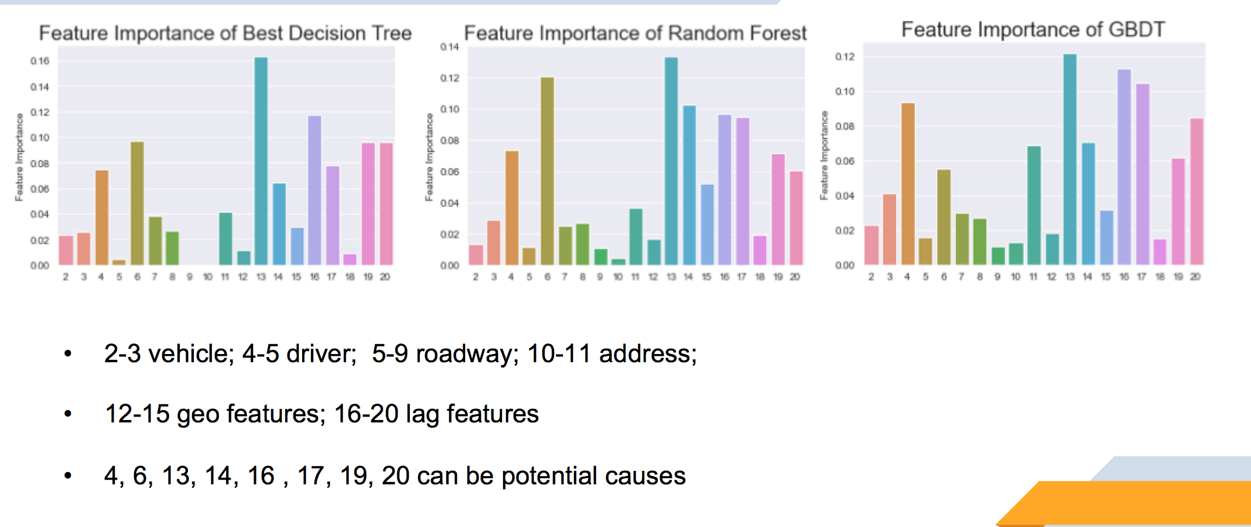
Results & Causal Analysis

Slide 27
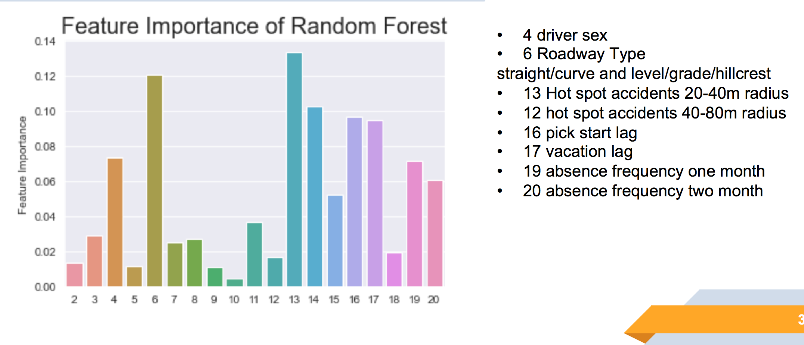
Results & Causal Analysis

Slide 28
Model Performance
Models with 10-fold cross-validation results
Models | Accuracy | f1 @0 on Test | f1@1 on Test
M1: LR+l1 | 70.27% | 77.55% | 56.00%
M2: RF | 68.92% | 75.59% | 56.60%
M3: DT | 59.46% | 66.67% | 48.28%
M4: MLP | 59.45% | 67.39% | 46.42%
M5:XGB | 58.10% | 65.93% | 45.61%
28

Slide 29
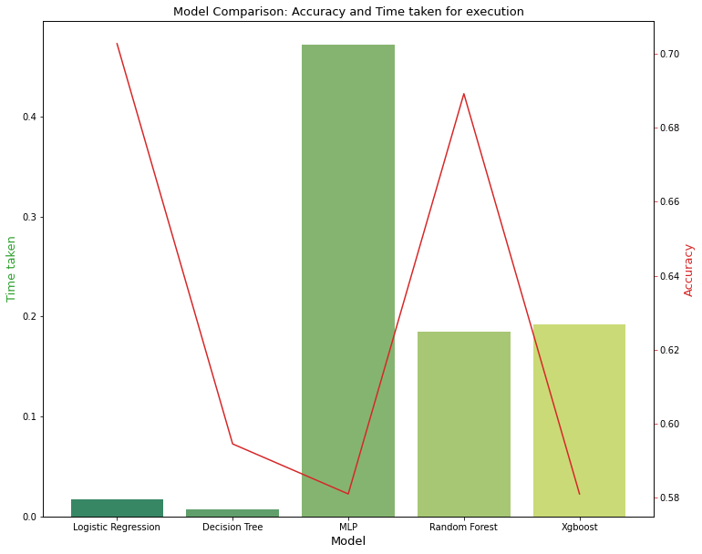
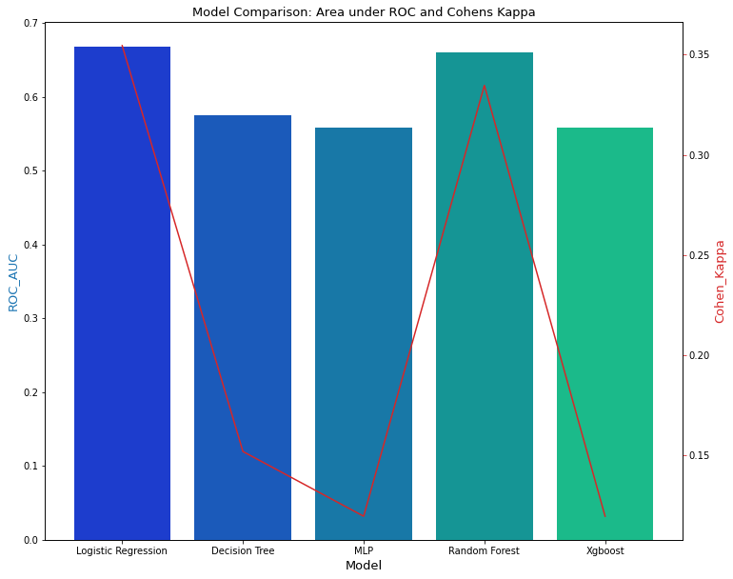
Model Comparison
29

Slide 30
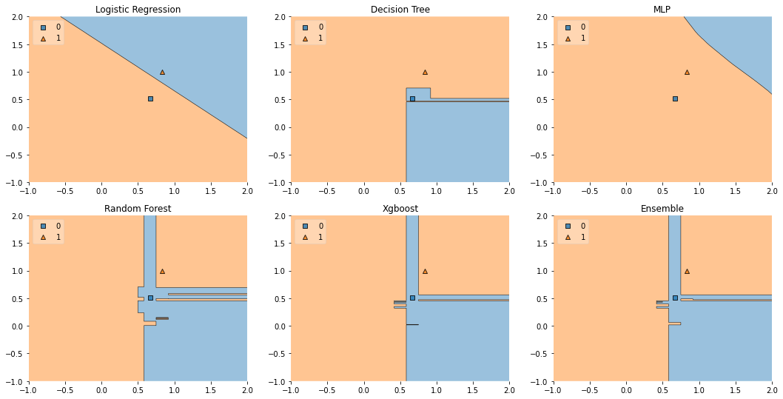
Model Comparison
Decision boundary on three most important features
30

Slide 31
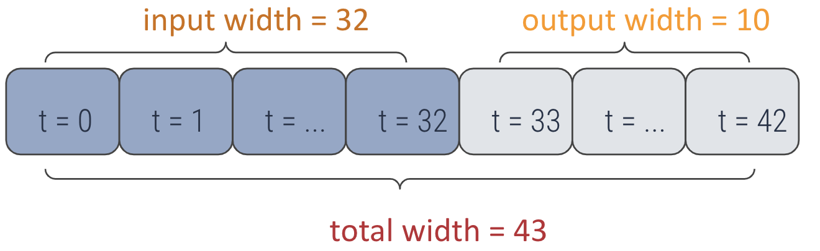
Timeline models：Failed Efforts
Goal: Find Patterns in Operator Data
Use only operator timeline features to predict accidents
Correspond with real-life application
Deep Learning models(CNN/RNN), autoregression
Figure：An illustration of deep learning predictive model
Result: No Correlation Found
Low accuracy, slightly better than flip a coin. DL agree with autoregression.
Maybe there is no explicit pattern in operator timeline data.

Slide 32
Causal Analysis
4
Notes:
Now let us come to our fourth part

Slide 33
Causal Analysis – Logistic Regression
4.1
Notes:
Third,

Slide 34
Drop Useless Features
Drop 6 features: 'AccTypeCodeDescr', 'AccSubTypeCodeDescr', 'acctype', 'BAITFISH Code’ ,
'FileNumber’ , 'Retraining'
Can’t know before happen
Data leakage

Slide 35
One Hot Encoding
1099
Columns!
RoadwayWeather
0
1
0
1
2
1
3
……
RoadwayWeather0 | RoadwayWeather1 | RoadwayWeather2 | RoadwayWeather3
1 | 0 | 0 | 0
0 | 1 | 0 | 0
1 | 0 | 0 | 0
0 | 1 | 0 | 0
0 | 0 | 1 | 0
0 | 0 | 0 | 0
0 | 0 | 0 | 1
…… | …… | …… | ……
Logistic regression won’t treated them as numerical values
The categorical feature is not ordinal (No multicollinearity)
One Hot
Encoding
Encoded Feature
Notes:
One-Hot Encoding is a technique for treating categorical variables. It simply creates additional features based on the number of unique values in the categorical feature. Every unique value in the category will be added as a feature.

Slide 36
Train/Test Split
One hot Encoded Data
(497, 1099)
Training Set
(397, 1099)
80%
Test Set
(100, 1099)
20%

Slide 37
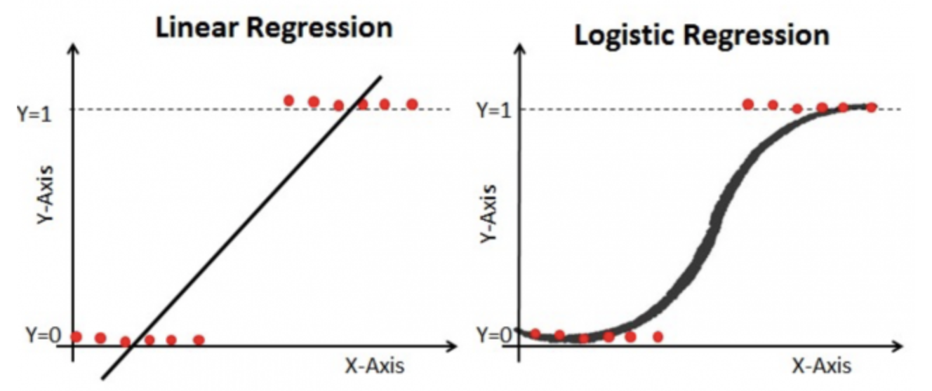
Introduction to Logistic Regression
use when the dependent variable(target) is categorical.
maximize the likelihood of the hypothesis that the data are split by sigmoid
Notes:
In a nutshell, the idea behind the process of training logistic regression is to maximize the likelihood of the hypothesis that the data are split by sigmoid.
Logistic Regression is used when the dependent variable(target) is categorical.

Slide 38
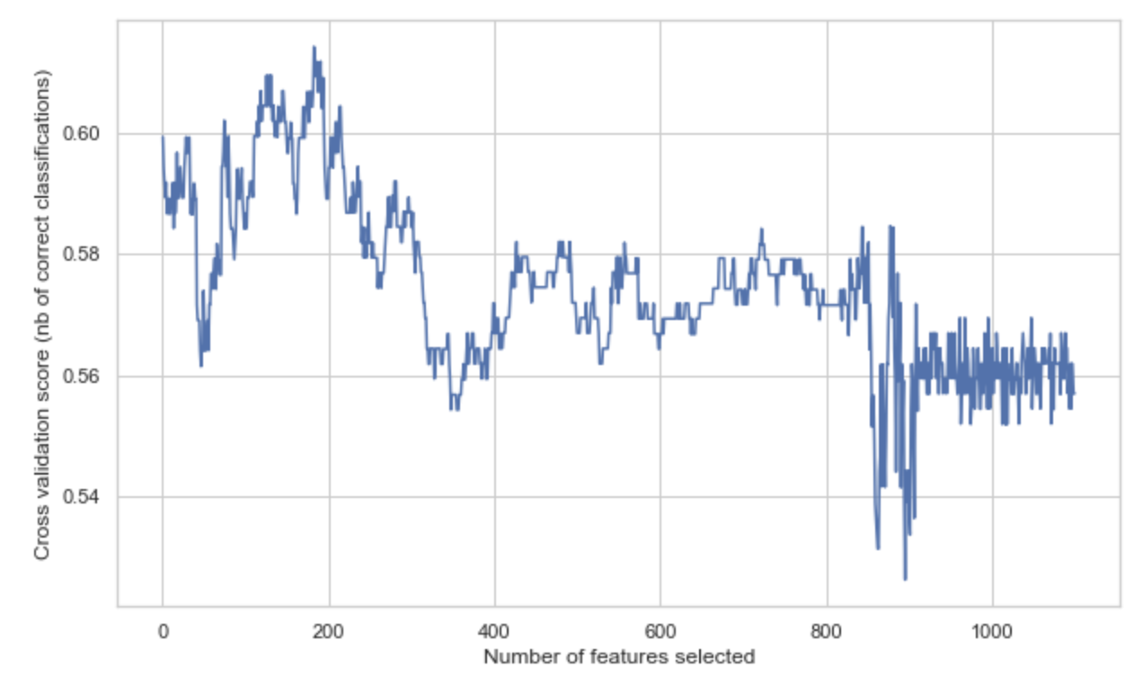
Recursive Feature Elimination
Cross-validation scores VS number of features
Selected features:
['Operator_ID_105’,
'Operator_ID_109’,
……
'accday__7’,
'freq_absence_one_week’]
183
Notes:
To deal with the problem of feature explosion, we performed RFE in a cross-validation loop to find the optimal number of features. The x-axis is the number of features selected, and the y-axis is the "accuracy" score which is proportional to the number of correct classifications.
Here after a recursive feature elimination applied on logistic regression with automatic tuning of the number of features selected with cross-validation, we can see the optimal number of features is 183.
And We put these selected features in our logistic regression model.

Slide 39
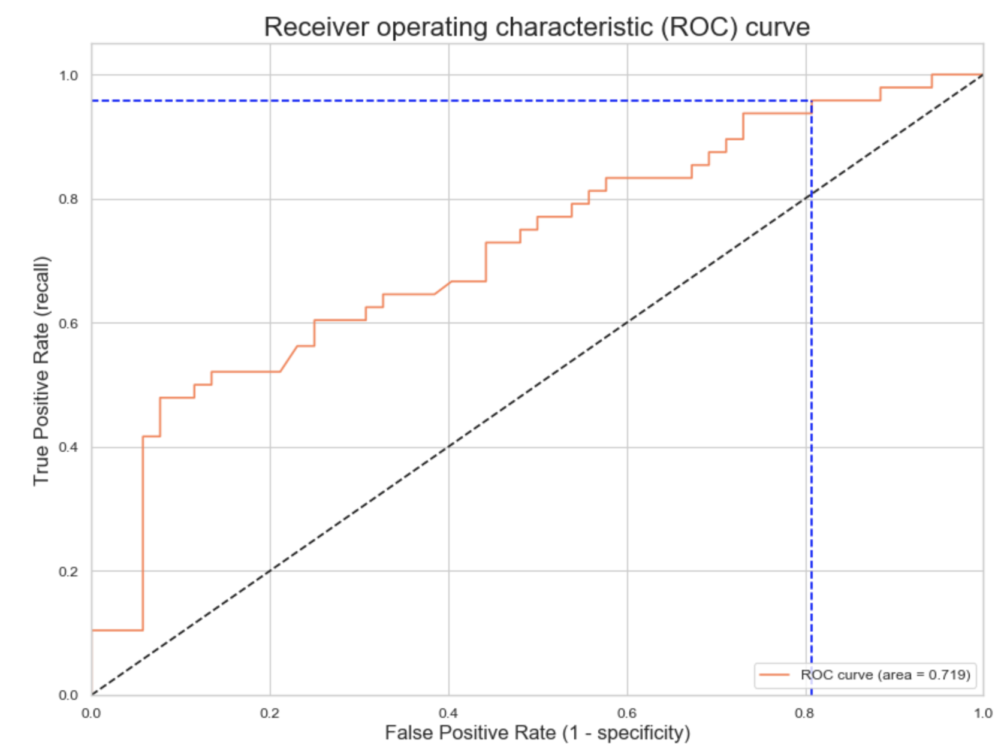
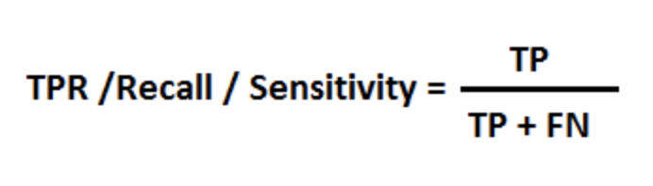
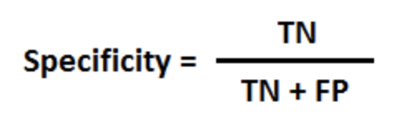
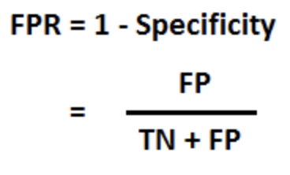
ROC – AUC Curve
Threshold = 0.165
0.958
Test score: 0.711
AUC: 0.719
0.81
Notes:
AUC - ROC curve is a performance measurement for classification problem at various thresholds settings. Threshold ROC is a probability curve and AUC represents measure of separability. It tells how much model is capable of distinguishing between classes. Higher the AUC, better the model is at classification.
Using a threshold of 0.165 guarantees a sensitivity of 0.958 and a specificity of 0.192, i.e. a false positive rate of 0.81.

Slide 40
Causality Result
Weight | Feature | Note
0.0320 ± 0.0344 | Neighborhood_25 | 0
0.0220 ± 0.0080 | SpeedLimitCategory_6 | SC8 (<11 km/h)
0.0180 ± 0.0294 | Roadway_5 | Straight and Level
0.0160 ± 0.0271 | Roadway_3 | Other
0.0160 ± 0.0098 | SpeedLimitCategory_3 | SC5 (51-70 km/h)
0.0140 ± 0.0098 | LocAddr1_128 | 1372 E.Main St
0.0140 ± 0.0098 | Roadway_0 | Grade and Curve
0.0120 ± 0.0080 | Operator_ID_249 | Id = 249
0.0120 ± 0.0080 | accday__7 | 7th data every month
0.0120 ± 0.0196 | Operator_ID_182 | Id = 182
0.0100 ± 0.0000 | Roadway_1 | Curve and Level
Limitation!
40
Notes:
Now let’s look at the causality result
We use the coefficients returned by the logistic regression model as weight and find out causes of preventable accidents. Feature the features after the one hot encoding while note indicates the corresponding value of the feature in the original data, which indicates its meaning in the real life. We can see from the result that the top feature is Neighbourhood_25, unfortunately it is a missing value because it is 0 in the original data, so not a lot meaning of that. But when we look at the followings, we can find something. Let’s take Speed Limit for example, …. Also, we can look at the road way. That may cause…

Slide 41
Causal Analysis – Logistic Regression After Covariance Term
4.2
Notes:
Third,

Slide 42


Defining causal analysis
When road is slippery Preventable Accident = 1%
Non-preventable Accident = 2%
ratio 1 = Preventable / Non-preventable = 0.5
When road is not slippery Preventable Accident = 0.5%
Non-preventable Accident = 0.5%
ratio 2 = Preventable / Non-preventable = 1
We will focus on the ratio lift here: causal effect = ratio 1 - ratio 2 = 50% less
Translation: Slippery road causes 50% less likely to be preventable accidents

Slide 43

Causal vs Predictive Modelling
In causal analysis:
We hate covariance between variables
We hate hidden variables we didn’t observe:
New drivers on the road?
Rochester becoming NY state capital?
...
Assume hidden variables stay stable

Slide 44
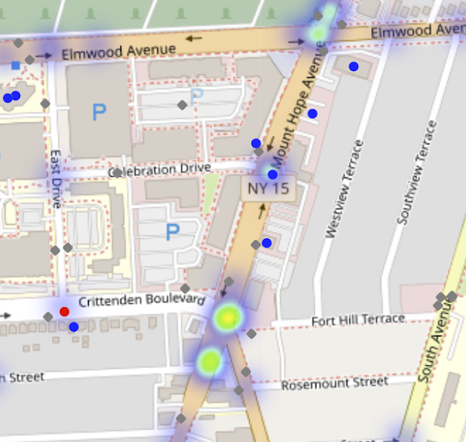

Method: Use independent variables
Criteria: Variance_inflation_factor << 5 (standard)
Geolocation:
Hotspot
Bus stop distance
Neighborhoods
Driver age
Drive gender
Lag variables (of the driver):
Days since absence
etc ...
Month or seasons
Hour of the day
isWeekend
Bus age
etc...
Roadway condition
Roadway light
Roadway Surface
Roadway Weather

Slide 45
Causal model: logistic regression
How confident we are
How big the effect & Prevalence
How big the effect is
Very Likely causes: Neighborhood
 | Correlation | Causal effect | P_value
Neighborhood__33_vs_25 | 0.049975 | Totally preventable | 0.999741
Neighborhood__12_vs_25 | 0.070746 | Totally preventable | 0.997555
Neighborhood__39_vs_25 | 0.070746 | Totally preventable | 0.996898
Neighborhood__27_vs_25 | 0.03109 | 27.8% more preventable | 0.809414
Neighborhood__42_vs_25 | 0.009661 | 26.5% more preventable | 0.833052
Neighborhood__25 (Baseline) | NA | NA
* Causal effect = exp(coefficient) -1

Slide 46
Causal model: logistic regression
 | Correlation | Causal effect* | P_value
SpeedLimitCategory__0 (comparing to 4) | 0.049975 | Totally preventable | 0.999721
SpeedLimitCategory__1 (comparing to 4) | -0.04034 | Not preventable | 0.999748
RoadwayLightConditions__4_vs_2 | 0.034483 | 23.7% more preventable | 0.908607
Roadway__2_vs_5 | -0.00947 | 16.3% less preventable | 0.86083
Likely causes
* Causal effect = exp(coefficient) -1

Slide 47
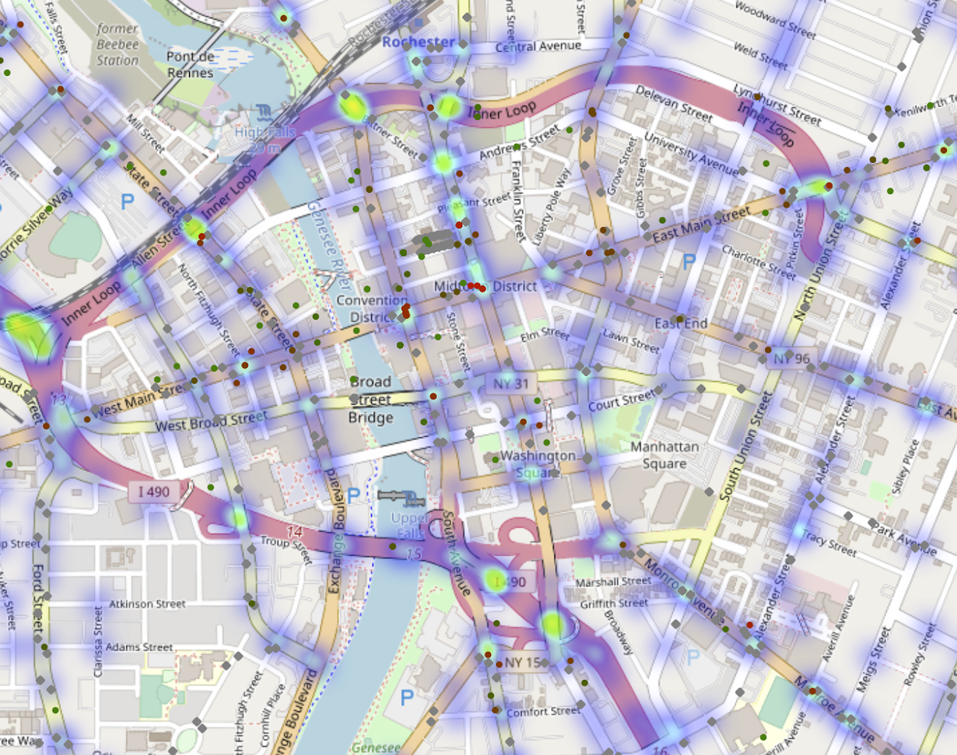
Geoinformation Output
An interactive map to show:
Accident hotspots
Bus stops
Past accidents
Hotspot is correlated with not preventable

Slide 48
Future Work
5
Notes:
Now let us come to our fourth part

Slide 49
Future Work
Wrap up code and dashboard
Come up with business suggestions
Compile report

Slide 50
Acknowledgement
Thanks for
RTS Quality Service Team
Professor Ajay
Professor P.J.

Slide 51
THANKS!
Any questions?

